Slide 1
P2P Data Leakage (Disk Image and Partitions)
Malcolm Hayward
University of Baltimore
Forensic Science – Cyber Investigations

Slide 2
Objectives
Verify the integrity of the disk image.
Determine the layout of the system’s files
How are the partitions set up?
Where are the boot files?
Which volume has Kamryn’s files?
What file system does the system use?

Slide 3
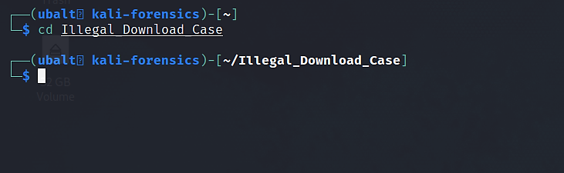
Make sure you are in the lab folder

Slide 4
1. Generate an MD5 and SHA1 hash of the disk image. Do they match the hash values that were given?
Tools Used:
MD5deep
SHA1deep
Hashdeep (alternatively)
MD5sum (optional)
SHA1sum (optional)
These tools will compare the MD5 and/or SHA1 hash of the disk image to the MD5 and/or SHA1 hash in the ‘hash_reference.txt’ file.
GUI Tools to consider: GTKHash

Slide 5
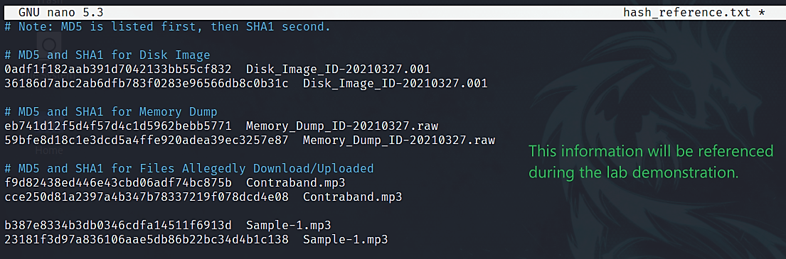
How to use MD5/SHA1deep
Check the integrate of files
Important arguments (options) for this command -
-b: prints the file name only, not the full file path (Ex. Image.dd instead of /root/lab/image.dd)
-e: gives you an estimated time for the command to finish calculating the hash
-w: if there is a match, the matching file’s file name will be printed to tell you which file the calculated hash code matches with
-M: allows the tool to compare the calculated hash code with a hash code from the given file
Commands –
md5deep <disk image> -bewM <file that contains file names and hash codes>
sha1deep <disk image> -bewM <file that contains file names and hash codes>
Note: You would replace <disk image> with the file path to the disk image. The same applies to anything else contained in between ‘< >’.
Notes:
0ADF1F182AAB391D7042133BB55CF832 Disk_Image_ID-20210327.001
36186D7ABC2AB6DFB783F0283E96566DB8C0B31C Disk_Image_ID-20210327.001
EB741D12F5D4F57D4C1D5962BEBB5771 Memory_Dump_ID-20210327.raw
59BFE8D18C1E3DCD5A4FFE920ADEA39EC3257E87 Memory_Dump_ID-20210327.raw
F9D82438ED446E43CBD06ADF74BC875B Contraband.mp3
CCE250D81A2397A4B347B78337219F078DCD4E08 Contraband.mp3
B387E8334B3DB0346CDFA14511F6913D Sample-1.mp3
23181F3D97A836106AAE5DB86B22BC34D4B1C138 Sample-1.mp3

Slide 6
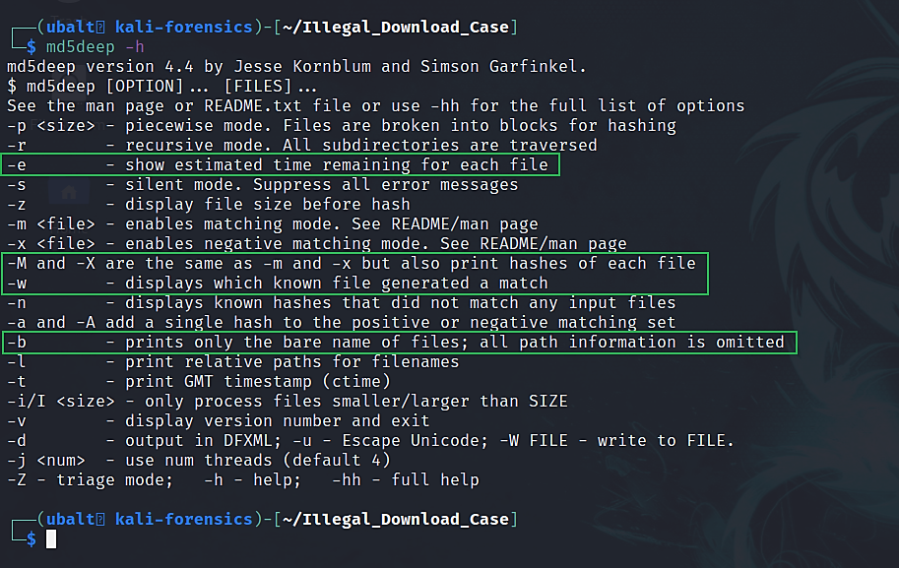
How to get help for MD5/SHA1Deep.
Note: SHA1Deep has the same options.

Slide 7
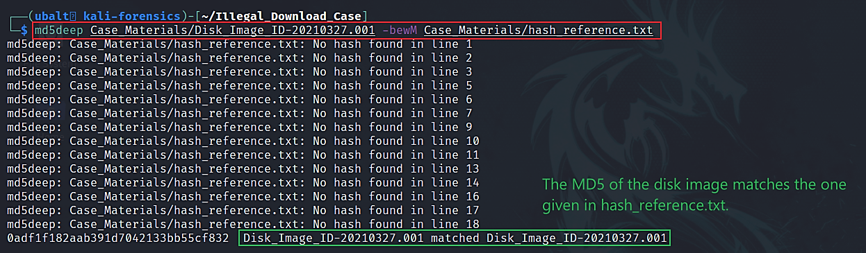
Use MD5deep to verify the MD5 hash of the disk image.
Notes:
0ADF1F182AAB391D7042133BB55CF832 Disk_Image_ID-20210327.001
36186D7ABC2AB6DFB783F0283E96566DB8C0B31C Disk_Image_ID-20210327.001
EB741D12F5D4F57D4C1D5962BEBB5771 Memory_Dump_ID-20210327.raw
59BFE8D18C1E3DCD5A4FFE920ADEA39EC3257E87 Memory_Dump_ID-20210327.raw
F9D82438ED446E43CBD06ADF74BC875B Contraband.mp3
CCE250D81A2397A4B347B78337219F078DCD4E08 Contraband.mp3
B387E8334B3DB0346CDFA14511F6913D Sample-1.mp3
23181F3D97A836106AAE5DB86B22BC34D4B1C138 Sample-1.mp3

Slide 8
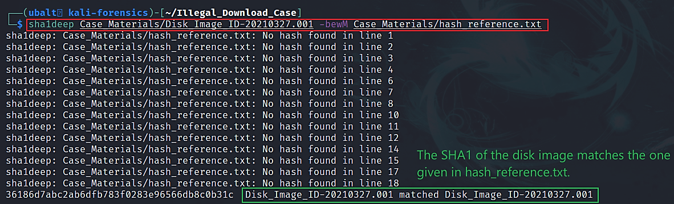
Use SHA1deep to verify the MD5 hash of the disk image.

Slide 9
Explanation
The MD5 and SHA1 hashes of the disk image are:
MD5 - 0adf1f182aab391d7042133bb55cf832
SHA1 - 36186d7abc2ab6dfb783f0283e96566db8c0b31c
MD5/SHA1Deep generated the MD5 and SHA1 hash, and then compared them to the above hashes that were in hash_reference.txt.
The output from the commands returned that they matched; therefore, the disk image is validated as being the one provided for this lab.
Notes:
0ADF1F182AAB391D7042133BB55CF832 Disk_Image_ID-20210327.001
36186D7ABC2AB6DFB783F0283E96566DB8C0B31C Disk_Image_ID-20210327.001
EB741D12F5D4F57D4C1D5962BEBB5771 Memory_Dump_ID-20210327.raw
59BFE8D18C1E3DCD5A4FFE920ADEA39EC3257E87 Memory_Dump_ID-20210327.raw
F9D82438ED446E43CBD06ADF74BC875B Contraband.mp3
CCE250D81A2397A4B347B78337219F078DCD4E08 Contraband.mp3
B387E8334B3DB0346CDFA14511F6913D Sample-1.mp3
23181F3D97A836106AAE5DB86B22BC34D4B1C138 Sample-1.mp3

Slide 10
Alternate Ways of Answering the Question
Hashdeep can do what MD5/SHA1deep did; however:
You must generate the hashes using hashdeep itself before you can compare hashes. Hashdeep will not accept the format used by md5/sha1sum, which is the format the ‘hash_reference.txt’ uses.
The command input is different from MD5deep and SHA1deep and requires more input arguments (options) to get the same result; therefore, hashdeep is the more difficult option.
Both MD5sum and SHA1sum will generate their respective hashes, and then you would compare them to the hashes given in hash_reference.txt or <location of the hashes>.
GTKhash is a GUI program that will calculate both hashes, and then you would compare them to the hashes given in hash_reference.txt or <location of the hashes>.
Think of GTKhash as being ‘HashCalc’ for Linux.

Slide 11

2. Identify the OS of the system as well as its name, accounts, and partitions.
These tools (aside from fsstat) will output the partition information of the disk image. Fsstat will retrieve the partitions’ file system information.
Tools used:
Fdisk
Fsstat
Mmls (optional)
Parted (optional)
Regripper
Compname plugin
Samparse plugin
Timezone plugin
Winver plugin
Hivexsh (optional)
GUI tool to consider: Gparted
These tools will analyze registry files to obtain the version of Windows, name of the system and the user accounts.

Slide 12
How to use fdisk
fdisk is one of the tools you can use to display a partition table.
We will use this tool to print the partition table that Kamryn’s system used.
Important argument (option) –
-l: display the partition table
Command:
fdisk –l <disk image>

Slide 13
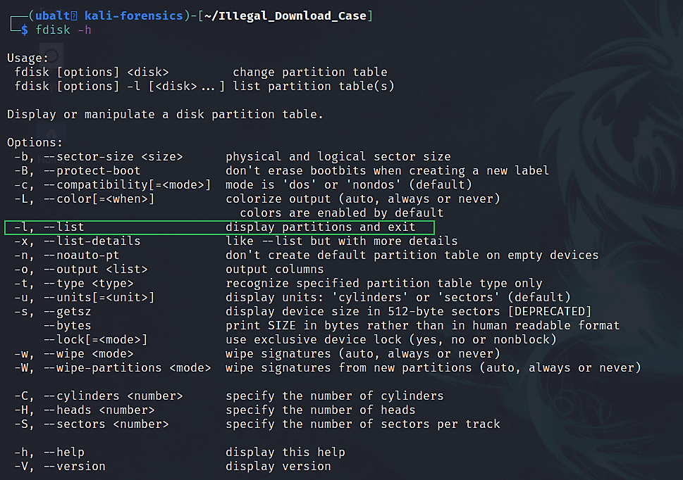
How to get help for fdisk.

Slide 14
What is a partition?
Before an operating system is installed on a hard drive, the hard drive only has unallocated space.
Space must be allocated on the hard drive to install the operating system. This allocated space is in the form of partitions.
Partitions are volumes of allocated space. The operating system sees partitions as valid places to store files.
The data for these partitions are stored in the partition table.
Each partition is formatted with a file system.

Slide 15
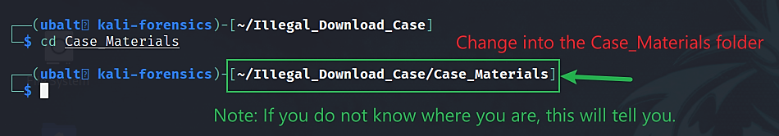
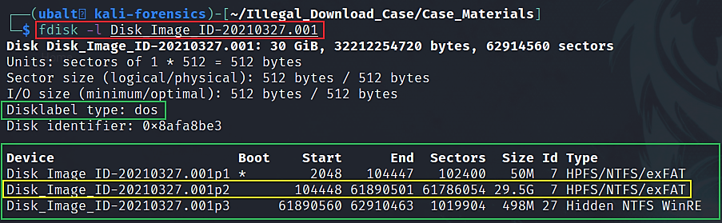
Use fdisk to get the disk image’s partition table.
Volume offset #s (in sectors):
Partition 1 – 2048
Partition 2 – 104448
Partition 3 - 61890560

Slide 16
How to use fsstat.
fsstat will give you the file system information of a partition.
The tool requires that you include the offset of the partition you want the tool to be used on. This tells the tool where to look for information.
You will see the offset number (in sectors) in the ‘start’ column from the fdisk output.
1st partition: 2048
2nd partition: 104448
3rd partition: 61890560
If you do not include an offset number, the tool will not know which partition to look in, and it will not work.
Command –
fsstat –o <offset number> <disk image>

Slide 17
What is a file system?
A file system governs how files are named, stored and accessed in a partition.
The output of fdisk shows partitions that have the NTFS file system.
The NTFS file system maintains important files that can provide evidence:
Master File Table (MFT) – stores records of each file such as file name, size, type (a file or folder), etc.
Update Sequence Number (USN) Journal – stores records of file changes such as file creation, file renaming, file deletion, etc.
And other artifacts!

Slide 18
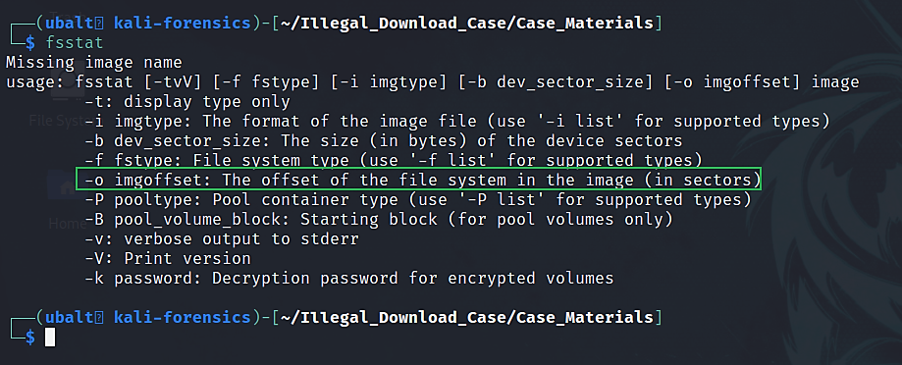
How to get help for fsstat.

Slide 19
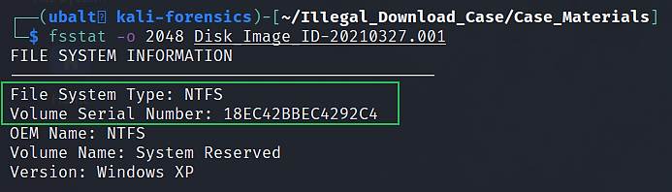
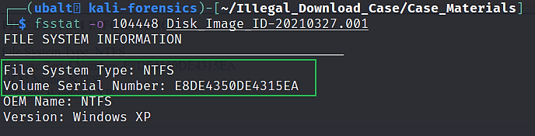
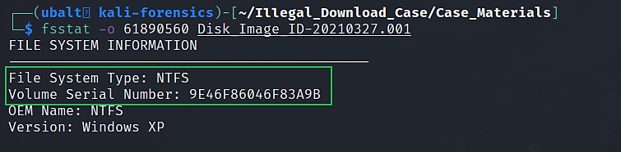
Use fsstat to get file system details.
Partition 1
File System: NTFS
Serial Number: 18EC42BBEC4292C4
Partition 2
File System: NTFS Serial Number: E8DE4350DE4315EA
Partition 3
File System: NTFS
Serial Number: 9E46F86046F83A9B

Slide 20
Explanation
Using fdisk and fsstat, we obtained this information:
Partition Table |  |  | MS-DOS | MS-DOS
Partition | Flag | Start | End | Sectors | Size | File System | Serial #
1st Partition – System Reserved | Boot | 2048 | 104447 | 102400 | 50 MB | NTFS | 18EC42BBEC4292C4
2nd Partition | - | 104448 | 61890501 | 61786054 | 29.5 GB | NTFS | E8DE4350DE4315EA
3rd Partition | - | 61890560 | 62910463 | 1019904 | 498 MB | NTFS/Hidden NTFS WinRe | 9E46F86046F83A9B
Note: The ‘Size’ column may vary with mmls, parted, and gparted.

Slide 21
Explanation
The 1st partition has a boot flag.
The files that the operating system needs to boot are in this partition.
The 2nd partition has the user’s files.
When we mount this disk, we should be looking at this partition.
The 3rd partition is a recovery partition.
This partition allows a user to factory reset their system.

Slide 22
What this means for the investigation.
The 2nd partition is where we will acquire evidence.
Knowing that the offset number (in sectors) is 104448 for the 2nd partition will be very helpful when using Sleuthkit-related tools.
Many of them require the user to specify the offset number. If you do not, then the tool will not know which partition to look in, and it will not work.
We know we are working with a Windows system because the partitions are using the NTFS file system.
Being aware of what file system you are working with helps you understand what tools to use and what artifacts you can extract from it.

Slide 23
Alternate Ways of Answering the Question
mmls displays identical information when you use the –B flag.
The only difference is that mmls will round the partition sizes down.
Also, it does not show which partition has the boot flag.
gtarted shows almost identical information to fdisk.
All of the values are human-readable.
It shows the 2nd partition having 31.6 GB.
gparted is an option if you want a GUI.
This tool shows the 2nd partition having 29.46 GB (can anyone verify and explain why?)
Notes:
1021 Linux =1k in Win

